Slide 1
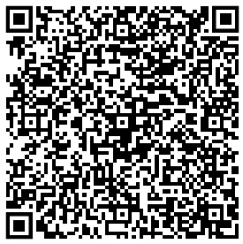
OSINT Beware your data is out there
CELFOCUS HACKATHON – 17/06/2024

Slide 2
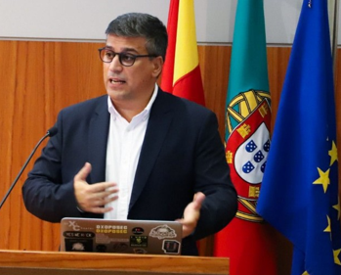
$whoami
Pedro Vieira
Cyber Security Engineer
Certified Ethical Hacker
Degree at University of Minho
2

Slide 3
Disclaimer & Laws

Slide 4

Disclaimer Boring but necessary
Information in this presentation is intended for educational and awareness purposes only.
Live presentation. Not a controlled environment and some contents may be inappropriate for some users.
I accept no responsibility in any kind for the use, misuse, downloading, viewing in whatever way the links in this presentation.
This presentation is not related to my work or employer.
4

Slide 5

Disclaimer Avoid illegal activities
Some links, websites, software or other items listed may or may not be legal, illegal, a felony, misdemeanor, or worse, in your country.
Please make sure that you are allowed to browse the websites, download links and software BEFORE USING!
Ignorance about laws or rules is no excuse for illegal activities or wrongdoing.
Illegal activities may get you in trouble or arrested.
Always check what is legal, and what laws apply.
5

Slide 6
Laws Portuguese Law and Organizations
Laws
Diário República Eletrónico (link)
ANACOM (link)
Organizations
CNCS – Centro Nacional de Cibersegurança (link)
Incident Notification (link)
CERT.PT (link)
Unidade Nacional de Combate ao Cibercrime e à Criminalidade Tecnológica (UNC3T) (link)
Ministério Público (link)
6

Slide 7
Awareness

Slide 8
Awareness Internet knows and doesn’t forget
Posted information privately can get publicly and world available by someone else
When information is posted
Shows when and where (habits & routines)
Internet has memory
Arquivo.pt (link)
Example (link)
Internet Archive - Wayback Machine (link)
Example (link)

Slide 9
Awareness Profile
Mobile number (Same number longevity)
Sync.Me (link)
Username
WhatsMyName (link)
Email (Username reuse)
Gmail (link)
Social media (Username reuse)
Facebook (link)
LinkedIn (link)
Tinder (link) (link)

Slide 10
Awareness Maps
Never been there. Know it like the back of my hand.
Street view
Google Street View (link)
Map/ Satellite view
Google Maps (link)
Overpass Turbo (link)
Wizard: plant:source=nuclear
World Imagery Wayback example (link)
Tips, Tricks and Techniques (link)

Slide 11
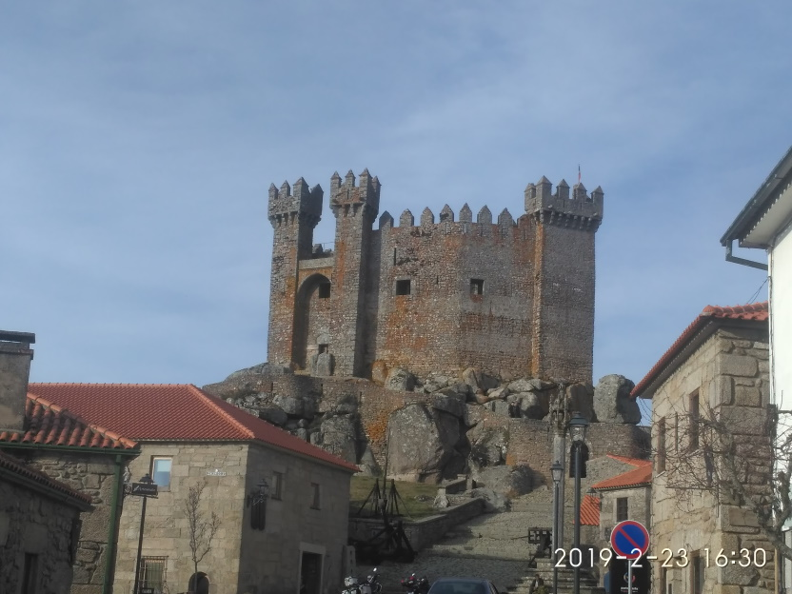
Awareness Photos
Photo analysis
Location
Date it was taken
Identifying elements in the photo
Image search
Identify the castle (link)
11

Slide 12
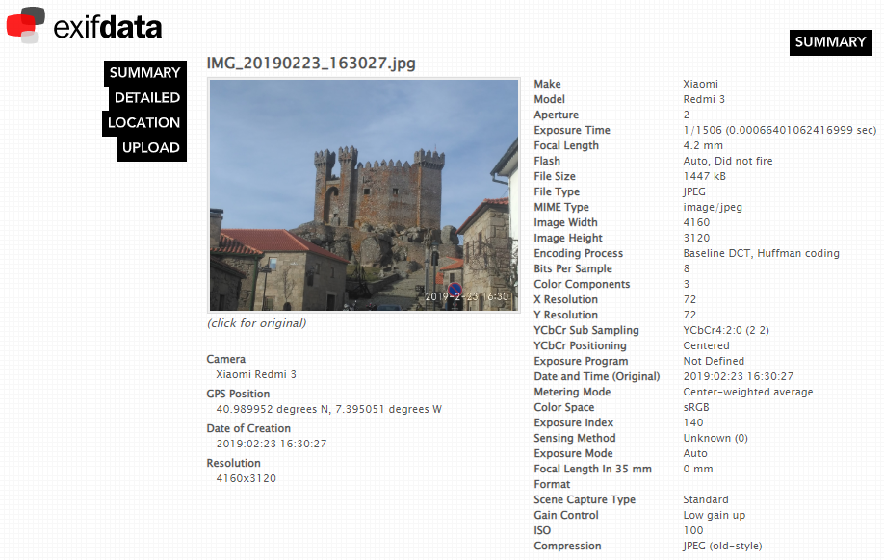
Awareness Photos
A picture is worth a thousand words.
File analysis
Metadata
GPS (link)
Google Maps (link)
Tools
CleanUp (link)
AperiSolve (link)
12
Notes:
https://raw.githubusercontent.com/pedroaovieira/osint/main/presentation/IMG_20190223_163027.jpg

Slide 13
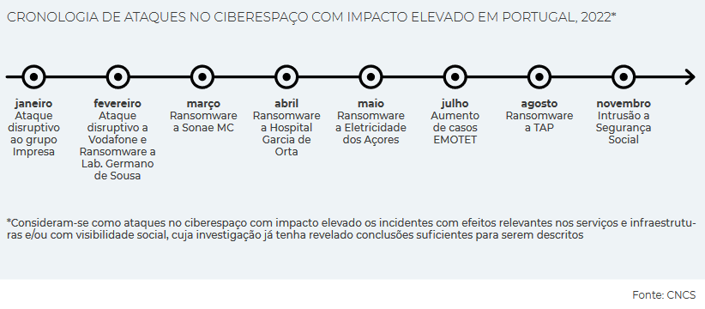
Awareness When companies are hacked
When companies are hacked, private data is exposed. Private data becomes “public”.
Troy Hunt
HaveIBeenPwned (link)
Pwned websites (link)
Domain search (link)
CNCS Report
Cybersecurity in Portugal 2024 (link)
Cybersecurity in Portugal 2023 (link)
Notes:
mmaraujo@dps.uminho.pt

Slide 14
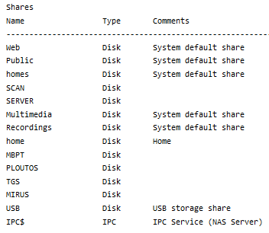
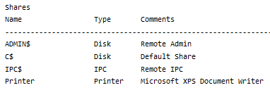
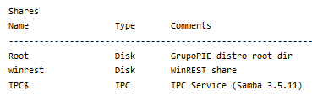
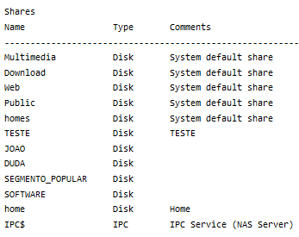
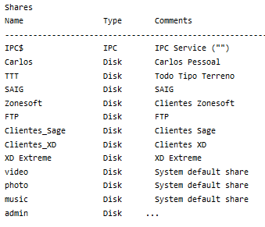
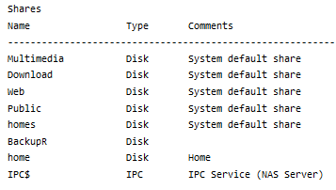
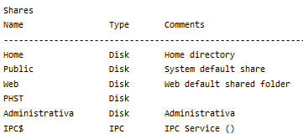
Awareness IOT Search engines
Shared folders accessible to 8 thousand million people (link)
Contabilidade – 6
Clientes – 3
Faturacao – 1
Faturacao – 2
Primavera – 6
SAGE – 13
Winrest – 148
14

Slide 15
OSINT Time
“Information is not knowledge”
Albert Einstein

Slide 16
OSINT – Open-source intelligence Digital Footprint
Open-source intelligence (OSINT) is the collection and analysis of data gathered from open sources (overt and publicly available sources) to produce actionable intelligence. (Wikipedia)
Gathering information from:
search engines (Google, …)
social media (Facebook, …)
government sites
maps
…
And then extract/relate/infer new information with greater value/potential.
16

Slide 17
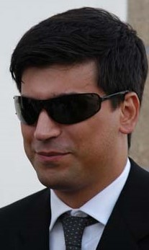
Who Am I? Search, and then search again
Starting with just a name
Pedro António Oliveira Vieira
Google (link)
Google “Improved Search” (link)
Google “Improved Search” + empresa (link)
LinkedIn (link)
Public profile was showing way too much (audit is needed)
Certified Ethical Hacker (link)
My github notes (link)
17
Notes:
https://www.linkedin.com/in/pedroaovieira/

Slide 18
Search Engines Internet is more than Google
Different search engine → different rules/crawlers → different results
Google (link)
Bing (link)
Yahoo (link)
DuckDuckGo (link)
Baidu (China) (link)
Yandex (Russia) (link)
SAPO (Portugal) (link)
You may ask to be removed from one search engine, not all ☹ (link)
18

Slide 19
Who are YOU? Search, and then search again
Search your name and analyze the results
As you saw the search can be improved
That is typically information to verify your identity over a phone call.
19

Slide 20
True stories

Slide 21
True stories Portugal
Store credit
Buying a book for almost no money Customer Card Right intel: mobile number and full name Credito on card
Customer data
Invoice request with NIF Name Address Updating customer data at the counter without documents
21

Slide 22
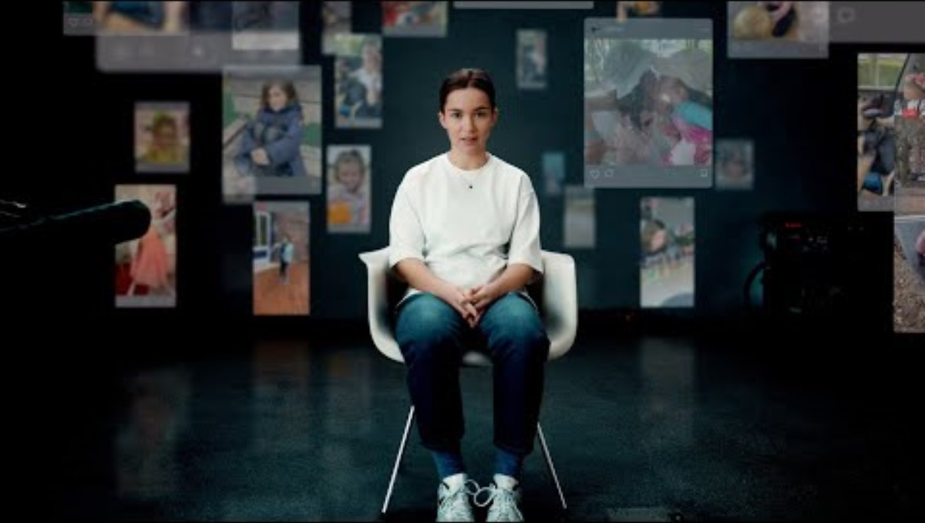

True stories Message from Ella | Without Consent
Deutsche Telekom Message from Ella | Without Consent
22

Slide 23
THANK YOU Q&A

